Slide 1
Programming Basics
Vivify Academy

Slide 2
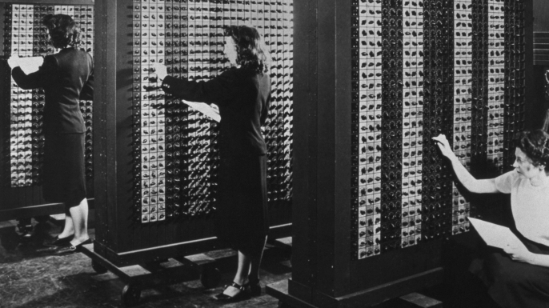
Programming

Slide 3
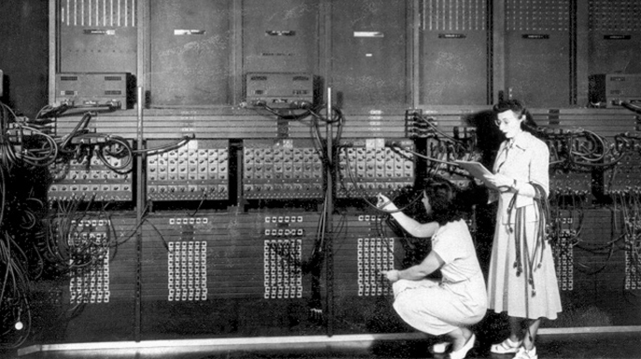

Slide 4
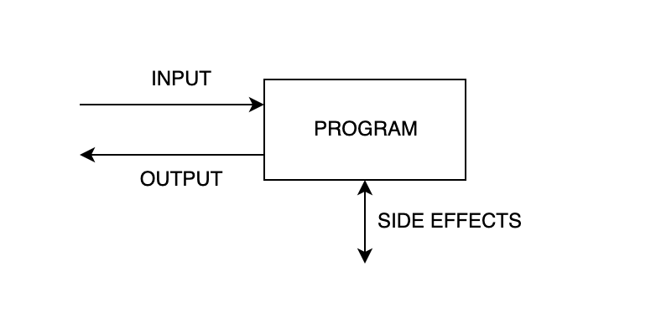
Programs are sets of instructions to the computer (including smartphones and similar devices) written with the goal of producing a desired outcome - either a certain output or a changed state of the system. Programming languages are human-readable languages that can be translated into instructions that the computer can understand.

Slide 5
Javascript
Also called ECMAScript language that was originally used for scripting in browsers, and has since become one of the most popular general-purpose programming languages. Today it can be used for server-side programming, for quick automation scripts, in some IoT devices, and even in some embedded systems.
When used in the browser, the program has access to the content of the page, the network and many other features. By making network requests and/or reading and changing the page, powerful applications can be created.

Slide 6
Running Javascript
We’ll be using Javascript in the browser, but most of what we cover can be used anywhere.
Create a simple HTML file
At the bottom of the <body> tag, add an opening and closing <script> tag
Inside the <script> element, write any Javascript code, e.g. console.log('ok')
In the browser, open the HTML file
Open the browser console
Windows/Linux: press F12
Mac: press Cmd-Alt-i

Slide 7
The Javascript program life cycle
Javascript programs are bound to the pages they’re used on. In our case, we create an HTML document and insert Javascript there, and that program is run when we load the page in our browser. The program is active as long as the page is open, but if we refresh the page the current state of the program is lost and it runs again from the beginning. When we need to test our program, all we need to do is change the code, save the file and refresh the page, and our new program will be run.

Slide 8
Basic syntax
Javascript, like most languages, is written as a series of commands, normally run one after the other. A semicolon (;) is usually written at the end of each statement. While it’s not mandatory, it’s good practice to always add them, to make it obvious where each statement ends.
Code is case-sensitive, so if you change the case of some text usually you will change behavior of the program.
Comments can be added by prefixing them with //. Comments don’t affect behavior, and can be used to clarify what a certain command does or why it’s needed.
Throughout most of the course, we will check results by printing them to the browser console. This is done by writing console.log(<value>), where <value> is replaced by whatever we want to print.

Slide 9
Values in programs
Almost all programs operate on some data. It can be provided by the user, read from some source (files, network...), be written directly in the program etc.
Data in programs is used as values - numbers, text, bit streams etc. Many values can contain multiple simpler values, for example a piece of text can be split into words or individual characters.

Slide 10
Examples of values
5
2.2
"Hello!"
true
5 + 2
10 / 2.5
2 > 8
(7 - 3) * (7 + 3)
literals of
single values
expressions

Slide 11
Literals
Certain values can be represented directly in the code. The various notations in programming languages for representing values like this are called literals. For each data type there is a separate literal syntax, for example strings (pieces of text) are written in quotes, numbers are written directly (without commas or spaces) etc. Javascript also has literals for some complex data types, which we’ll cover later.

Slide 12
Expressions
When we use one or more value in some operation, such as addition or multiplication, we have an expression. Expressions themselves can be combined, and are necessary to calculate new values from old ones. There are many operations we can perform on values, from well-known ones like arithmetic (addition, subtraction…) to operations that are specific to programming (assignment, conditional etc.).

Slide 13
Expressions vs statements
In Javascript, any expression can also be used as a statement. Statements are commands that are used to change the state of the program, such as writing to a console. On the other hand, expressions are typically used to calculate new values from existing ones, and don’t change the program state. However, this distinction is not absolute - there are certain commands that are both statements and expressions, and most (but not all) statements can be used as expressions and vice-versa.

Slide 14
Operations and operators
Operations on data produce new values for one or more existing ones. The values used in the operation are called operands, and the symbol that signifies the operation is the operator. Examples:
3 + 4 - The operation is addition. Numbers 3 and 4 are operands, and + is the operator. The result is the number 7.
0 > 1 - The operation is greater-than check. Numbers 0 and 1 are the operands, > is the operator. The result is the logic value false.
5 + 2 * 10 - There are two operations here, and standard order-of-operations rules apply. First, the multiplication operation of 2 and 10 produces 20, which is then used as the second operand in the addition operation with 5, ultimately producing the number 25.

Slide 15
Data types
Computers don’t care about the type of data (because they can’t); but humans do, and programming languages were made for humans. Humans generally don’t perform the same operations on letters and numbers - you wouldn’t try to multiply 5 by "A". However, this can happen by accident in programs, so languages usually implement checks to see if certain operations make sense and show an error if they don’t.
Programs that don’t make it obvious which data type is used where can be very difficult to understand.

Slide 16
Some simple (or “primitive”) types
Numbers, such as 1, 2, -3, 10, 5.5
Whole numbers, or integers: 1, 2, -100
Real numbers, or “floats”, or “doubles”: 1.2, 3.125 (using decimal point, not comma!)
Logical, or Boolean values - true and false are the only possible values
“Empty” values, such as undefined or null

Slide 17
Some simple (or “primitive”) types
Strings - sequences of characters, such as "Hello", "Javascript", "a"
Single letters are also strings
Strings can be empty: ""
They can also be written with single quotes: 'This is a string too!'
If you want to use the string delimiter (single/double quote) inside the string, precede it with a backslash (\)
For example:
'Conan O\'Brien'
"Conan O'Brien"
"Strings are written \"like this\""

Slide 18
Complex types
Other than these simple types, there are values that are usually used to contain other values, such as arrays, objects etc. Some of these values also have a literal representation in Javascript:
Arrays of values are written using square brackets [ … ]
Objects are written using curly braces { … }
We’ll cover these in more detail later.

Slide 19
Computers are stupid
Or, more accurately, they are not smart in the way humans are
They won’t understand what you meant
Their syntax is very strict, and they won’t tolerate some seemingly minor changes
They work according to certain rules, which you may not understand yet (but you will)
They are very literal: the string "a" is not the same as "A" (computers have no idea what letters are)
If you “forget” a letter or make a typographical error (“typo”), they usually won’t correct you but will only tell you something is wrong.
If you accidentally use the wrong word, operation etc., they may seem to work (don’t crash, no explicit errors) but you get the wrong result.
...

Slide 20
How we deal with computer stupidity - debugging
With time, we learn to recognize different mistakes we may make, and know where to look to fix the program
We control the program, so we can change (like stop it early) it to see exactly where the error occurs
If the program is small enough, we can “execute” it ourselves, on a piece of paper, to see what happens and at which point the program starts acting in a way we don’t expect
If an error occurs, the language will show you where it occurred, so you’ll have at least some idea where to start looking
If all else fails, we can google the error, or ask someone more experienced

Slide 21
How some errors can be caused
(2 + 3
"Some string
nonsense "Syntax"
console.log(1.2.3)
"Consecutive" "strings"

Slide 22
Variables
While a program is running, it can store relevant data in variables. Variables are named “containers” for data, and any type of data can be stored in a variable. Once some value is assigned to a variable, we can use that variable in any place where we need a value; the current value of the variable will “replace” it.
Variables are useful when we need to use the same value in more than one place. Also, we have to use them if we want to send a certain value to another part of the program, or if we don’t know what data we’ll be working with in advance (which we almost never know).

Slide 23
Syntax for variables
var minutesInHour = 60;
var secondsInMinute = 60;
var secondsInHour = minutesInHour * secondsInMinute;
Variable names can contain only letters, numbers and some other characters ($, _), and can’t start with a number. The language is case-sensitive, so variable a is not the same as variable A. Spaces can’t be part of the name, words are separated with uppercase letters (this is called “camel notation”).

Slide 24
Assignment
The = operator is not an equality check; equality checks are done with ===. Instead, the = symbol is used for assignment, or setting a variable’s value. This means that whatever is on the left side of the assignment operator will have its value changed to whatever is on the right side. Unlike equality checks or addition, you can’t switch the operands without changing the meaning of the program. In other words, a === b is the same as b === a, on the other hand a = b is NOT the same as b = a.

Slide 25
“lvalue” vs “rvalue”
Since whatever is on the left of the assignment operator has its value changed, there are restrictions on what can be on the left side - only variables and certain other parts of code can be assigned to. That means, if you try to run 5 = 10 you’ll get an error, because you can’t change the value of the number 5. On the other hand, any value can be used on the right side, any literal or expression - but certain statements are not expressions and can’t be used.
Variables also act differently depending on whether they are on the left or right side of the assignment operator. If they are on the right side, their value is read; if they are on the left, their value is changed. Thanks to that we can read the old and set the new value in the same statement:
a = a + 1; which can also be written as a += 1;

Slide 26
var x is not an expression
The variable declaration statement, such as var x, is one of the statements in Javascript that can’t be used as a value, meaning it’s not valid syntax to do this:
var x = var y
If you want to use the value of y, you’d have to declare it earlier with
var y
and then do
var x = y

Slide 27
The special undefined value
If you declare a variable but don’t give it any value, it will implicitly have the value undefined. This value is used for unset or nonexistent variables, and is also what you can see in the console when you run a statement that doesn’t have a value, or that’s not a valid expression.

Slide 28
Logic (boolean) values
Other than the relatively well-known numbers and strings of text, programming languages use so called logic or boolean values, of which there are only two - true and false. We already encountered them with the greater-than (>) operation, and also the result of any equality check is one of these two values. For example:
3 > 4 - the result is false
(5 + 5) === 10 - the result is true

Slide 29
Logic operations
Javascript (and most other languages) has a few operators meant to be used with boolean values.
AND operator (&&), which is true only if both operands are true
OR operator (||), which is true if any operand is true (or both)
NOT operator (!), which is the opposite of its (one) operand
Javascript allows operands of any type to be used in place of booleans, and evaluates them according to certain rules. For now we will be working with booleans only.

Slide 30
&&
The “and” operator. Result is true only if both operands are true, otherwise it’s false:
(true && true) is true
(true && false) is false
(false && true) is false
(false && false) is false
Used when multiple conditions must be satisfied:
canPlayOutside = doneHomework && notRaining

Slide 31
||
The “or” operator. Result is true if either or both of its operands are true, otherwise it’s false. It can also be stated as: result is false only if both operands are false, otherwise it’s true:
(true || true) is true
(true || false) is true
(false || true) is true
(false || false) is false
Used when any condition is enough:
mustStayInside = hasNotDoneHomework || raining;

Slide 32
!
The “not” operator. Result is true if the operand is false, otherwise it’s true:
!false is true
!true is false
Used to invert a condition:
canPlayOutside = !mustStayInside;
canPlayOutside = doneHomework && !raining;

Slide 33
Operators cheat sheet
Assignment | =
Arithmetic | + - * /
Compound assignment | += -= *= /=
Logic | && || !
Comparison | === == > < >= <= !== !=

